Slide 1

The Invasion of Unemployment and Video Games
By: Gabriel Andaya,
Alex Heang
Notes:
Gabriel

Slide 2
Introduction
Our goal is to find any correlation between Unemployment Rate in the United States and the sales of video games in the North American region from 2000-2017
Our research will define high unemployment in the US as any year or month above 5%
Anything below 5% as low unemployment rate
Video games will be analyzed by their platform popularity and at what years were sales highest inside the US
Platforms include: Xbox360, Wii, 3DS, Xbox, PS2, PS3, etc.
A correlation will be presented between unemployment rate by year with the sales of video games in North America by year
Notes:
Alex
Hypothesis - There will be a correlation between video game sales and the job market

Slide 3
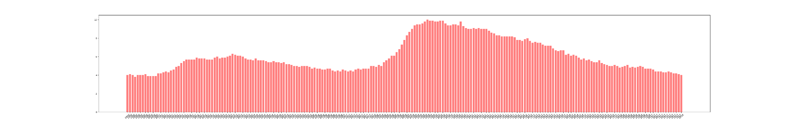
Unemployment Rate
There have been 149 months of high unemployment, and 68 months of low unemployment from 2000-2017.
The highest unemployment rate period being at 9.8% in September, 2009
The lowest unemployment rate period being at 3.8% in April, 2000
Notes:
Gabriel
We see a relatively high unemployment trend during the early 2000’s, which might be attributed to the dot com bust and then we see unemployment rate lower during 2003-2008.
Then we see the effect of the Great recession from 2008 take a large effect on the US Unemployment rate from 2008 to 2012 and we see a low recovery of the unemployment rate from 2010/2012.

Slide 4
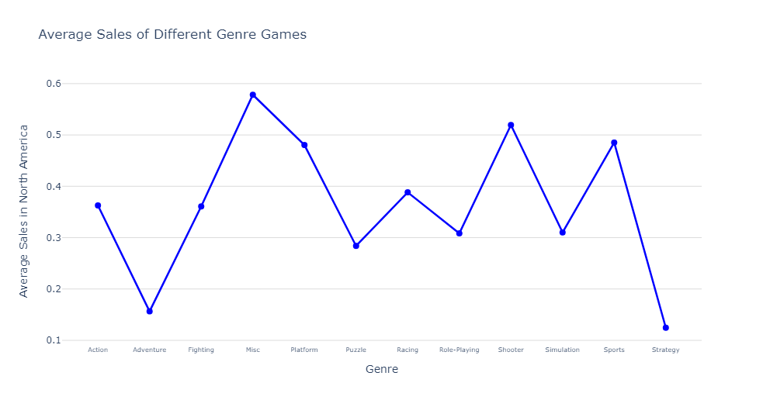

Video Game Sales NA
In North America, consumers prefer platform and shooter type of video games.
Platform games include the games such as Super Mario Bros.
Shooter style include games such as Call of Duty and Grand Theft Auto
Notes:
Gabriel
These are the types of video games that publishers may focus in developing to better increase their sales in the North American market.

Slide 5
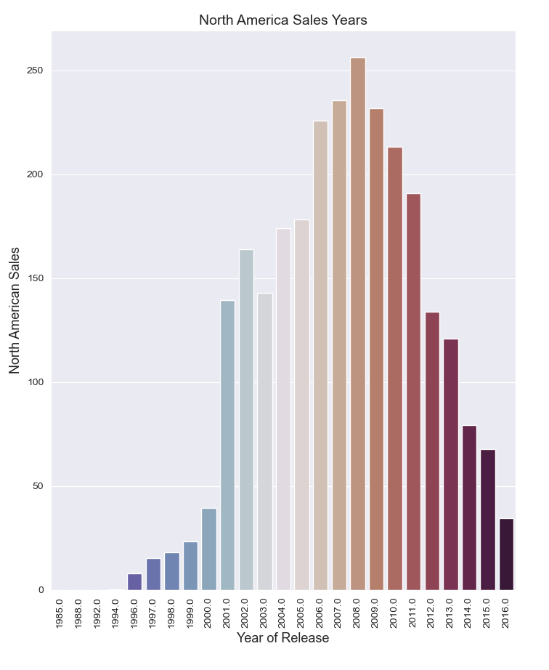
Annual Sales
The year 2008 had the most sales in North America with 256.25 million sales, and with 2007 coming second with 235.61 million sales in the region.
The year 2016 recorded the least amount of annual video game sales in the North American region with 34.52 million sales
Notes:
Alex
We believe this supports our hypothesis in that around 2008 the great recession started and we can see a downward trend in console video games from that point on

Slide 6
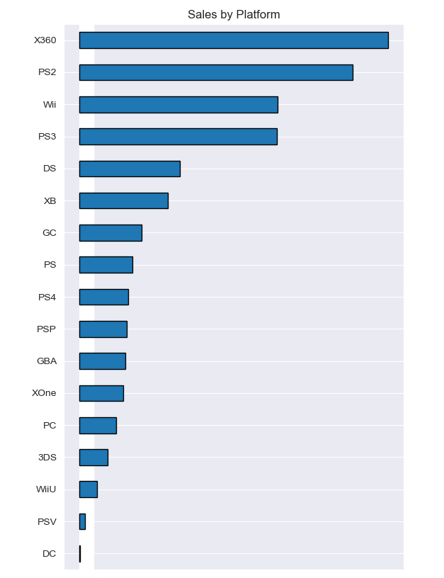
Platform Sales
Xbox 360 video games were the most popular in the North America region with 533 million sales from 2000-2017.
Publisher: Microsoft (USA)
2006 saw the highest sold video game with Wii Sports reporting 41.36 million sales in North America.
Publisher: Nintendo (Japan)
Five most popular consoles in NA from 2000-2017: Xbox 360, PS2, Wii, PS3, & DS
Notes:
Gabriel

Slide 7
Correlation
There may be a correlation between the unemployment rate and video game sales. Evidence that helps support this:
The decrease in video game sales as the job economy improved.
The impact of the 2008 recession where we saw the largest sales volume two years prior (in 2007 and 2008) which was also the start of the greatest job loss in recent history
In 2001 was the dot.com burst where many tech businesses were shuttered and jobs were loss (a mini recession), we can see a decline in video game sales after this period of time.
Notes:
Alex

Slide 8
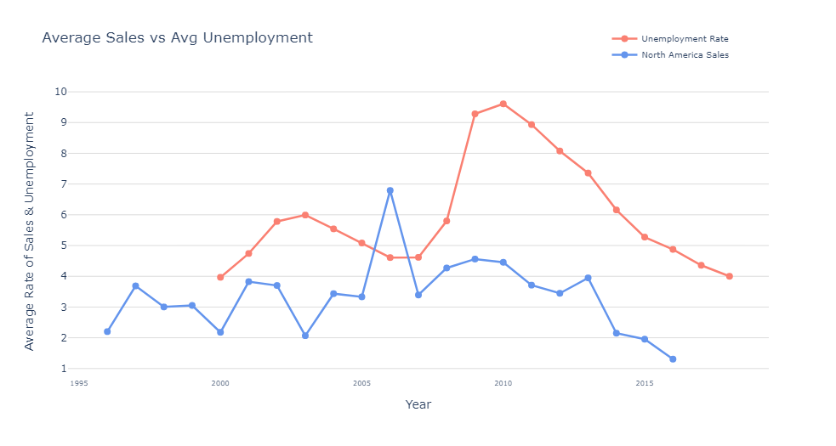
Notes:
Gabriel
Through merging both csv files, we see from the graph provided that there is some correlation between unemployment rate and video game sales in North America.
As unemployment shrinks, sales of video games rise as seen in years between 2005 and 2008. We see as unemployment rises, video games in North America fall, as seen between the years 2001 and 2004.
Another instance of low sales or lowering of sales and high unemployment is between years 2009 and 2013 during the Great Recession time frame.

Slide 9
Conclusion
Although we see a correlation between these two datasets, there may be other contributing factors which may influence video game sales. Some of these are:
The change in consumer behavior after 2010 from console gaming to mobile or PC gaming as they became more readily available
The growing popularity in casual gaming produced by independent studios which were not captured by these datasets
The advent of cloud video game streaming services and digital purchases
Notes:
Alex

Slide 10
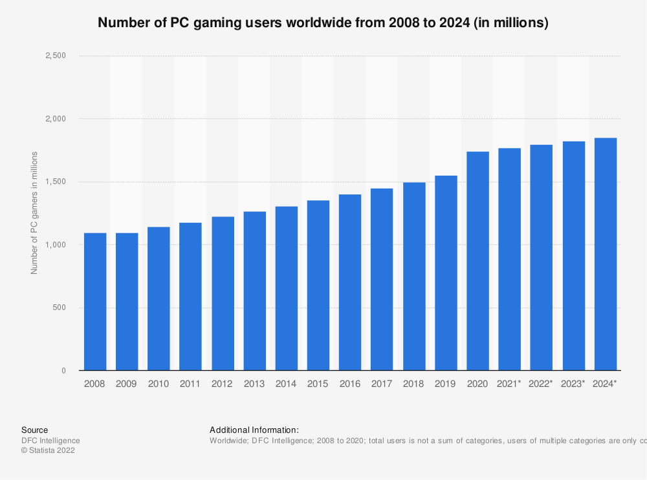
Conclusion
This bar chart shows the growth rate of PC gamers annually from 2008-2024 The information can shed some light onto why console gaming has decreased amongst gamers in our original dataset
Notes:
Alex

Slide 11
References
FRED: https://fred.stlouisfed.org/series/UNRATE
Kaggle: https://www.kaggle.com/datasets/gregorut/videogamesales
GitHub: https://github.com/Andaya334/Project-1.git
Statista: https://www.statista.com/statistics/420621/number-of-pc-gamers/

